Slide 1
Medical Records Audit Automation Data
Interns: Rutik Makwana, Anudeep Verma, Nikhil Kumar Pandey
Mentors : Bharathi , Raviraj , Bhuvan, Sriram, Hari, Amarendra
Notes:
Hello everyone, I am Anudeep Verma and with me I have Rutvik Makwana and Nikhil Pandey and We are working on automation of WCF portal. Our mentors in this journey were:- BHARTHI, RAVIRAJ, SRIRAM, BHUVAN, AMARENDRA

Slide 2
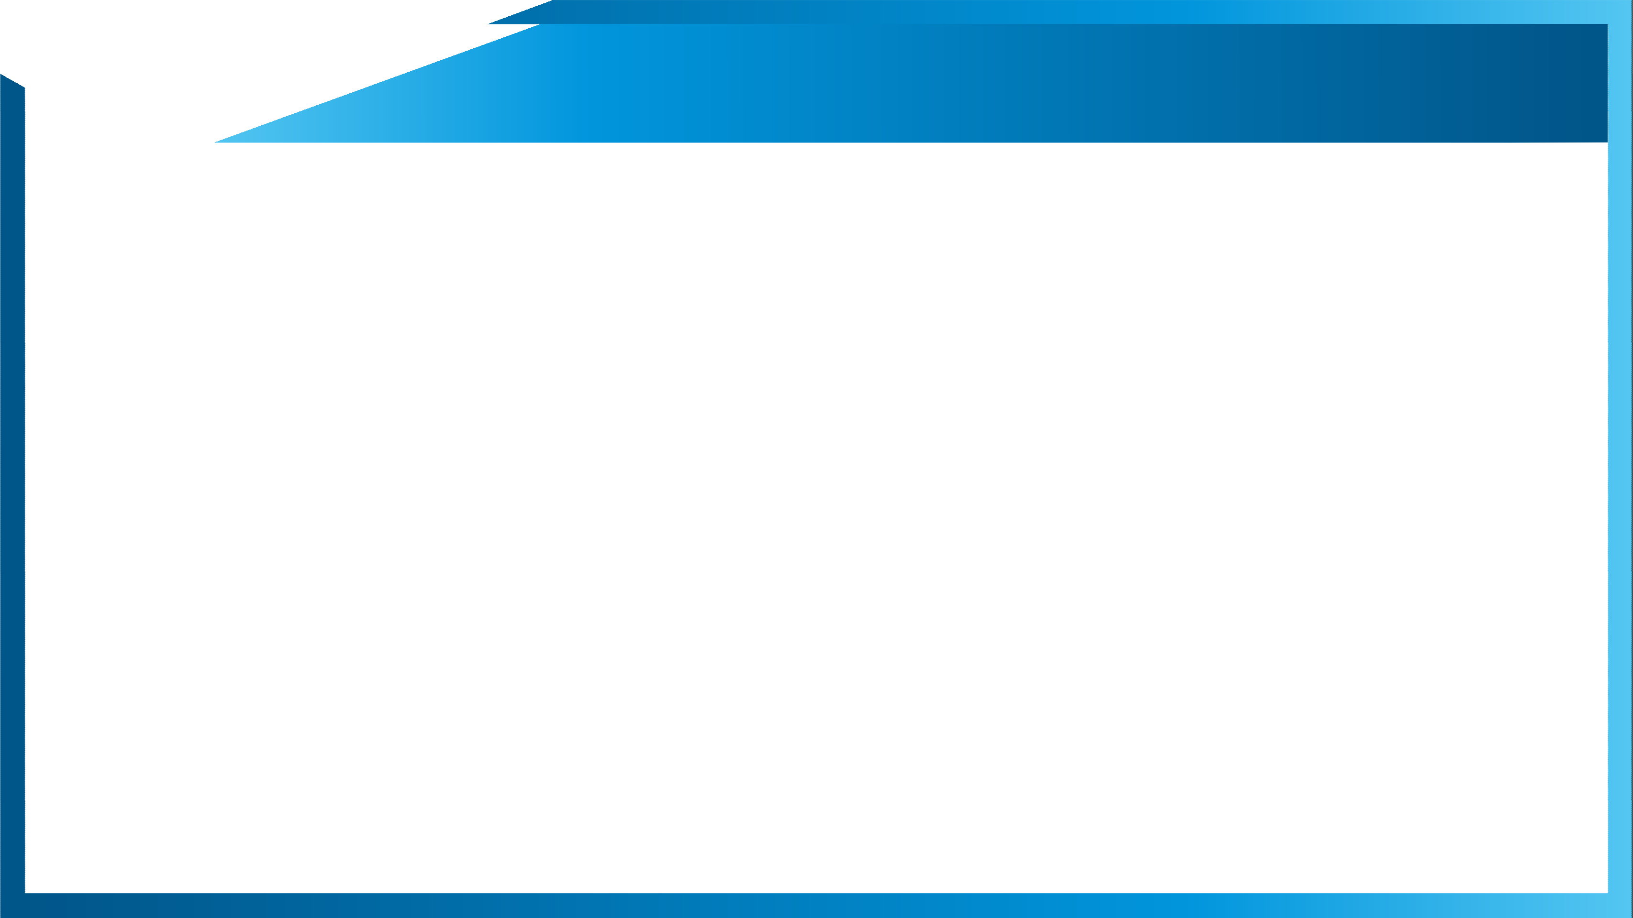


Agenda
Problem Statement & Objective
Milestones & Schedules
Solution Architecture
Approach
Software Requirements
Demo
Status
Feedback & Next Steps
Notes:
Our Agenda for today’s presentation is as below- starting from the problem, to milestones we achieved as we progressed, solns & approaches we found out, current status and future works to be done. In the end, we will have a demo of our work.

Slide 3
Problem Statement & Objective
Problem Statement
Extract the data from Claim forms and validate if Medical Record (MR) is found for a claim in WCF portal.
Objective
Automate the process of checking the correct medical record (present or not) for a manually processed claim in WCF portal.
Extract the data from the medical records using OCR engine and match it with the given data to verify its correctness
Extraction required fields from WCF Claim forms and feed it to the Bot
Notes:
So, the problem statement given to us goes like this - to automate the process of checking if the correct medical record is attached by the patient or not in the WCF portal, which till now had to be manually checked and processed.
For this problem statement, We defined our objectives as following:
automate claims processing by receiving the patient’s details from WCF Bot, namly- name, service date, billing npi, dob, dcn no, hc id.
Search and match the pdfs to verify if it is a medical records
Return a bolean value (T/F) if medical record is present or not.

Slide 4
Milestones & Schedules
Milestone 1
Milestone2
Milestone3
Milestone4
Start Date:27/05/2022
End Date:10/06/2022
Read business slides
Knowledge Transfer
Work on collab for dummy data
Successfully extracted text from dummy data
Outcome:
Understood the problem statement. Successfully implemented different approaches in dummy data. Started working with original data.
Start Date:11/06/2022
End Date:24/06/2022
Explored multiple approaches
Tried to implement research papers.
Finalized the approach giving best results.
Outcome:
After exploring different approaches finalized the approach. Successfully extracted the required data.
Start Date:25/06/2022
End Date:01/07/2022
Started Working on the automation process.
Solved the problems.
Initial demo and collect feedback
Successfully created a full working model.
Outcome:
Successfully created a working model of the automation process. Had an initial demo and feedback session.
Start Date:02/07/2022
End Date:15/07/2022
Model finalization
Feedback implementation
Improve performance using multiprocessing.
Outcome:
Improving the performance of the automation model using multiprocessing and reducing wait time and finalize the project.
Notes:
In the span of working with Legato, We have achieved three milestones up till now,
Started with understanding the Problem Statement and Knowledge transfer
explored various approaches to extract data,
Then automated the WCF portal for searching and finally summarizing everything to a working model after loads of debugging.
Now, We aim to achieve the 4th milestone as well in the coming 2 weeks.

Slide 5
Software Requirements
Claims Forms
Medical Form
Anaconda (Jupyter & Spyder)
Easyocr
Poppler
Internet Explorer 32-bit driver
Java 32-bit
Selenium
Notes:
Firstly, we need some system requirements like anaconda, easyocr, poppler to work with medical and claims form. For webscrapping, we need Selenium and IE 32-bit driver , 32 because its faster. Java 32 bit is needed to open the claim form when we are inside WCF portel.

Slide 6
Solution Architecture(Claims Data Extraction)
Convert Pdfs to images
Image Preprocessing
Take Out Required fields using indexing
Extract Data using OCR
Store Information in a Dictionary
Notes:
Now discussing about the soln achietecture, this slide presents a graphical representation of what we did for extracting required fields from claims form.
We first start with converting pdfs into the images and then apply some image processing approaches, i.e, crop out the boxes which contain required field.
then we use this image data and feed it into OCR to get the text inside it.
And lastly store the output data into the dictionary

Slide 7
Approach (Text Extraction)
Overview:
Program reads the Claims pdfs and converts them to image pages.
Using OpenCV, we make the grid by tracing the horizontal and vertical lines and crop out the image in boxes containing information.
Required information lies at specific index of the made image boxes list.
We extract text from specific indexes using easyocr to get the required fields and form a dictionary for each patient form.
Details:
Different approaches were used for generalizing this method for every form but were unable to get do it (with good accuracy)
We changed the method of extraction to contour detecting, changing kernel sizings, removing horizontal and verticals lines and then extracting
Tried libraries other than Pytesseract library, for text extraction, to different – pdfplumber, easyocr, pdfminer, textract, PyPDF2, and then found out that easyocr has the best accuracy having a little higher runtime.
Finalized easyocr after discussion with the team. Successfully extracted the required data from the given Claim forms.
Notes:
As you saw in previous slide, in our initial 4 weeks we worked on data extraction and finalizing the approach.
So, detailed explanation goes like this -
there were two kinds of forms provided to us from which we needed to extract some required fields and following operations were performed to reach to solution.
Firstly, the program is converting the pdfs into images with some preprocessing and library, then it is cropping the boxes from the pdf with proper indexing by detecting horizontal and vertical lines in the form using opencv and taking out detected boxes with specific indexes with have the required fields.
Further, we use easyocr to extract text insides image boxes and storing the extracted data in the form of dictionary with Patient name as the key, so we can later get all information of particular person using just his/her name if needed further.

Slide 8
Solution Architecture(WCF Automation)
Bot writes data in excel sheet
Script takes claim data from excel
Opens and login WCF filenet portal
Searches for the attachments
Download if present
Extract data and Match the required fields
Script writes T/F in the excel sheet.

Slide 9
Approach(WCF Automation)
Overview:
Bot writes the required fields such as DCN, HCID, Patient Name, DOB, Service Date, Creation Date, Provider’s Name and NPI from WGS into an excel sheet.
Our Python program takes the excel sheet as an input and performs the automation steps and gives a Boolean output (True or False) for each Claim entry whether a medical record is present or not.
Automation of WCF portal is performed using the Python Libraries- Selenium and Pyautogui and the Text Extraction from pdfs is performed using the libraries such as easyocr and pypdf2.
Details:
After taking the input from the Excel sheet, Our Program first opens the WCF filenet website and performs login operation by providing our username and password.
After Login, our program enters the filenet portal and select the claims corro extended search option in the dropdown.
Then an Extensive Search operation is performed to filter out the correct records for the claim data which is currently taken as input.
Notes:
As you saw in previous figure, our WCF automation approach starts with the bot writing the data of patient into a excel, from their our program reads it and open the WCF portal, logins and searches using different field which we will explain in detail later, download them and match certain field to check if it’s a medical attachment. Finally, We write True or False if it’s a medical attachment in another excel which the WCF Bot will read it and proceed further.

Slide 10
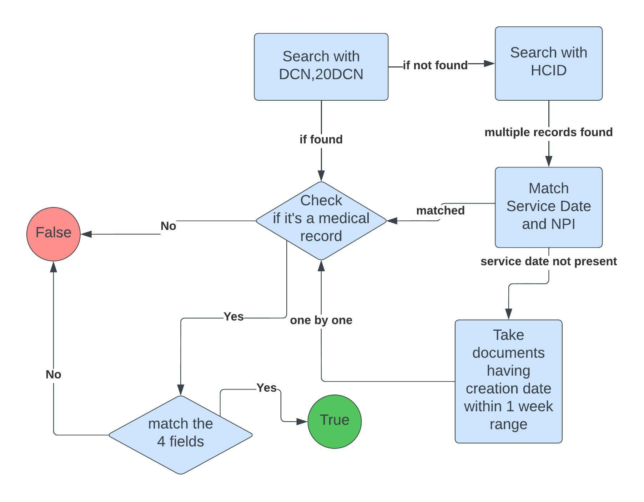
Approach
Searching Process
Notes:
Mention one by one
Matched with claim details

Slide 11

Status
Demo ready
lack 1 claim form, medical records
Challenges
optimization needed
random popup while opening pdf
Next Steps
Link script with Bot through API
Reduce sleep time (if possible)
Integrate remaining claim forms
Claim form text extraction not used currently
Timing issues (IE ☹ )
Downloading pdfs (IE ))
Use Multi-processing to reduce time.
Need to discuss with Hari
Need to update

Slide 12
Improvements(WCF Automation)
Speedup Downloading
Found out that attched document can reach upto 100 pages or more
Implemented method to download only first 5 pages, because only 5 pages could confirm the presence of medical record.
Logic to match the 4 fields
Some dates in the records were not in the same format that we were taking from the excel sheet hence implemented the logic to parse the dates in other possible formats so that it can be matched.
Implemented additional step while searching for the correct record
In the earlier program when a document was found using DCN which was not a medical attachment it was directly returning false instead a checking with HCID. Hence, implemented this additional step to continue the search even if medical record was not found using DCN.
Notes:
As you saw in previous figure, our WCF automation approach starts with the bot writing the data of patient into a excel, from their our program reads it and open the WCF portal, logins and searches using different field which we will explain in detail later, download them and match certain field to check if it’s a medical attachment. Finally, We write True or False if it’s a medical attachment in another excel which the WCF Bot will read it and proceed further.

Slide 13
Multiprocessing
Tried the following Python Libraries to achieve Multiprocessing
Threading
asyncIO
Multithreading
Issues faced with multithreading
Downloading part in the program is GUI Based (since we have no control for downloading in the website using the driver) hence, if multiple windows will open simultaneously the program won’t be able to interact with the GUI and the attachments won’t be downloaded.
Notes:
We would like to appreciate the help of Sriram, Hari, Amrendra, Raviraj.

Slide 14
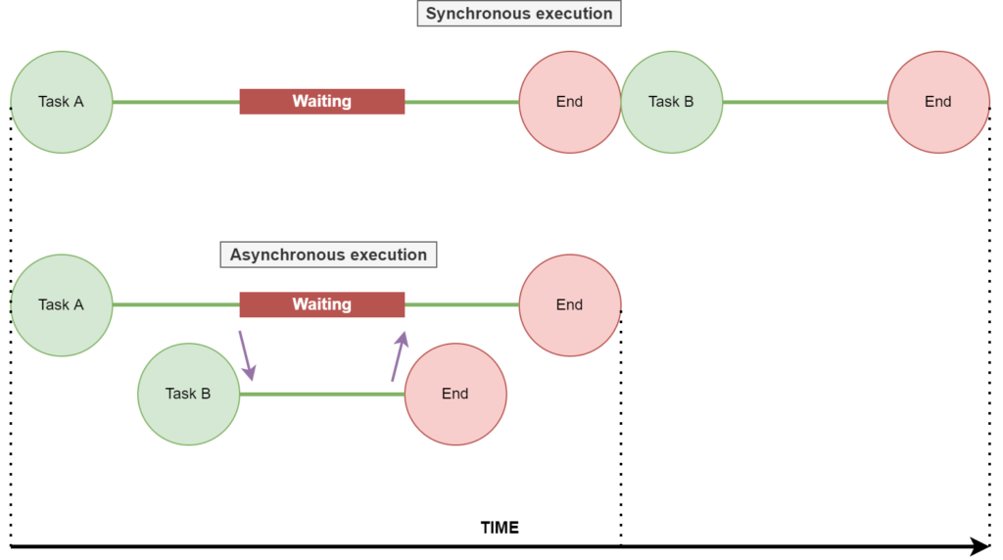
Multiprocessing
Our automation works in a synchronous way and multi-threading it will not work because each process should be executed only after previous step is executed completely ,i.e., they are inter-dependent. We tried to implement it but the sleep time encountered during downloading caused the next thread of checking the document to start which as expected gave error because the document hadn’t been downloaded.

Slide 15
Output Matrix
Need to update
0
0
0
107

Slide 16
WCF Automation
Text Extraction
Lots of Debugging ☹
DEMO

Slide 17
Thank You!!
Notes:
We would like to appreciate the help of Sriram, Hari, Amrendra, Raviraj.

Slide 18
Questions/Feedback

